Slide 1
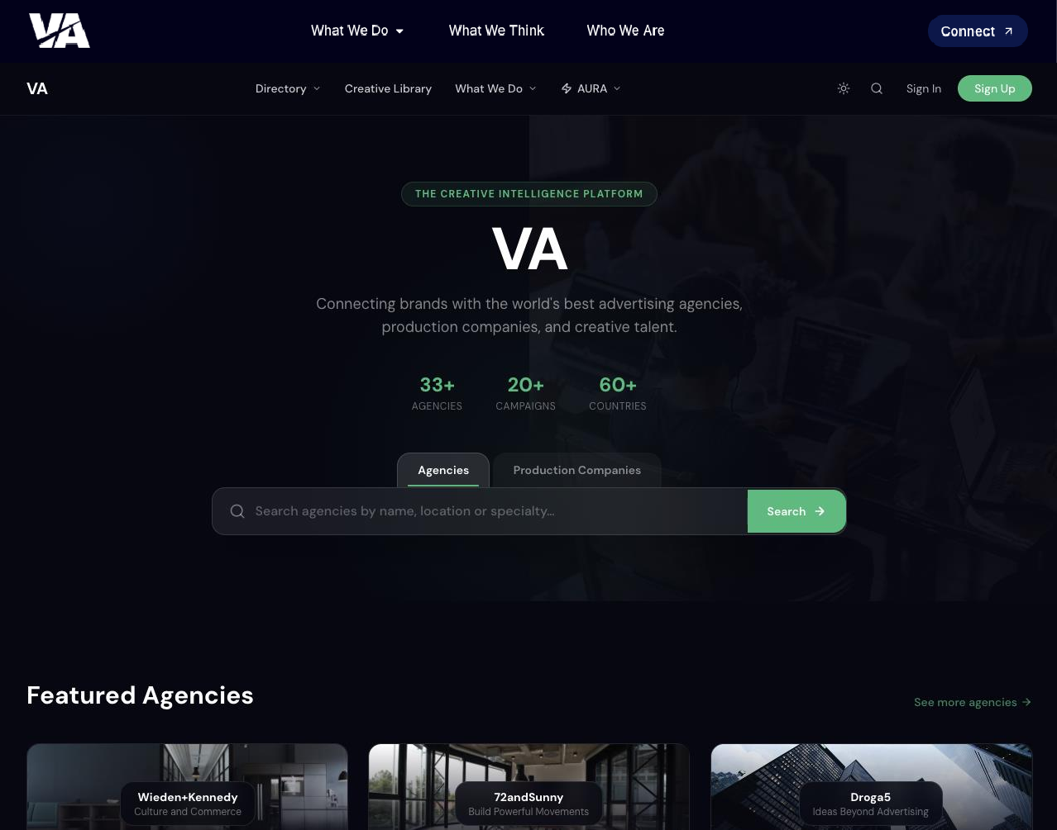
Aura
I would prefer to use
icons similar to those on AdForum, but centrally aligned.
To be define, at this stage you can
keep the possibility to write a text

Slide 2
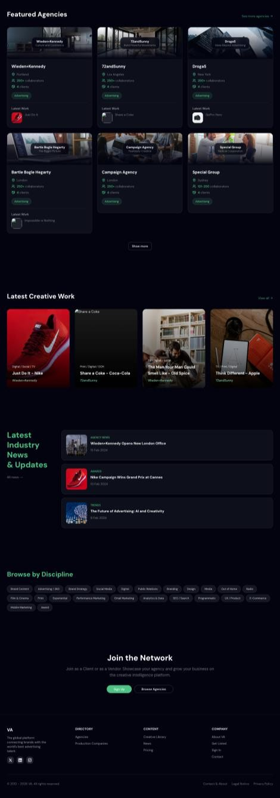
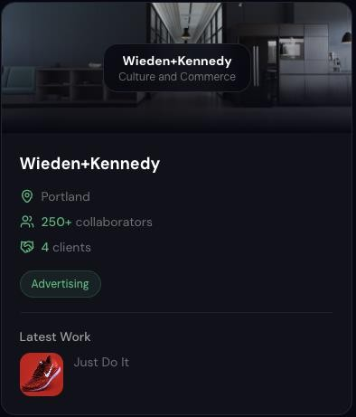
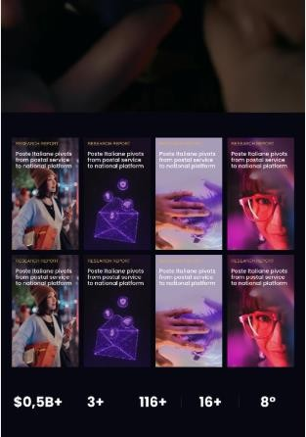

I assume the logo will be
placed here, using the same
format as Scanbook.
The dark mode used for the cards should be reconsidered by using our dark blue #02030E background.
Add another item «award»
Background must be on the same color of our current website #02030E
Hide this section maybe in a
second moment we can
connect what we already have
on our website
Remove this section
Ok but we need to think at a copy as «join the network» as a client or as vendor with the
same sign up
I guess you will take our footer once you will embed in our template

Slide 3
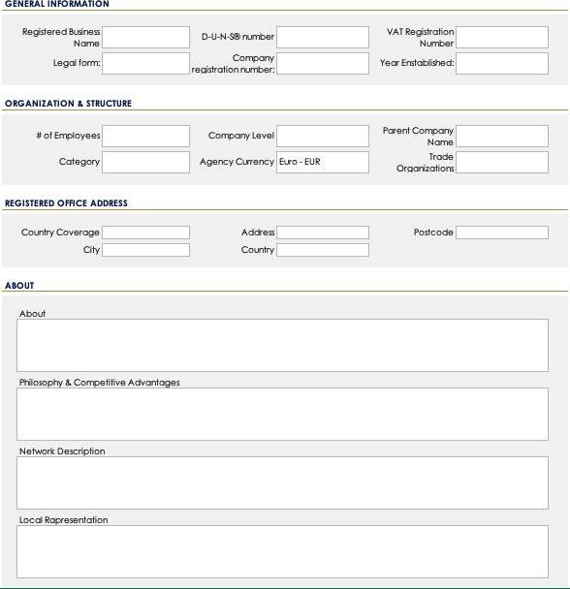
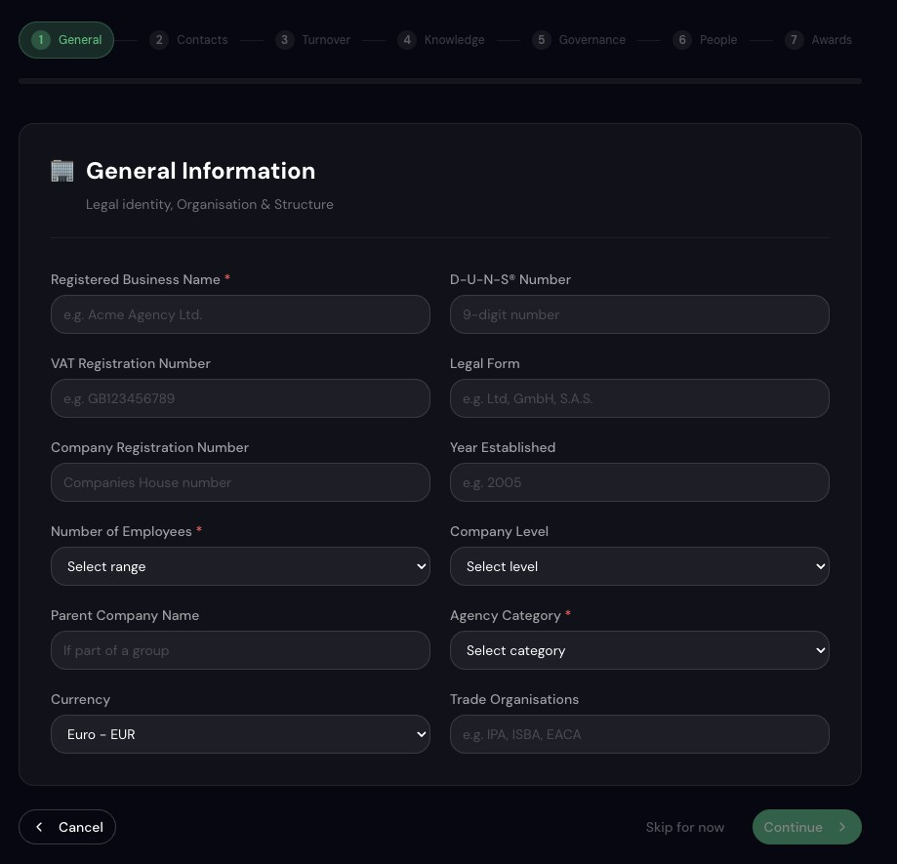
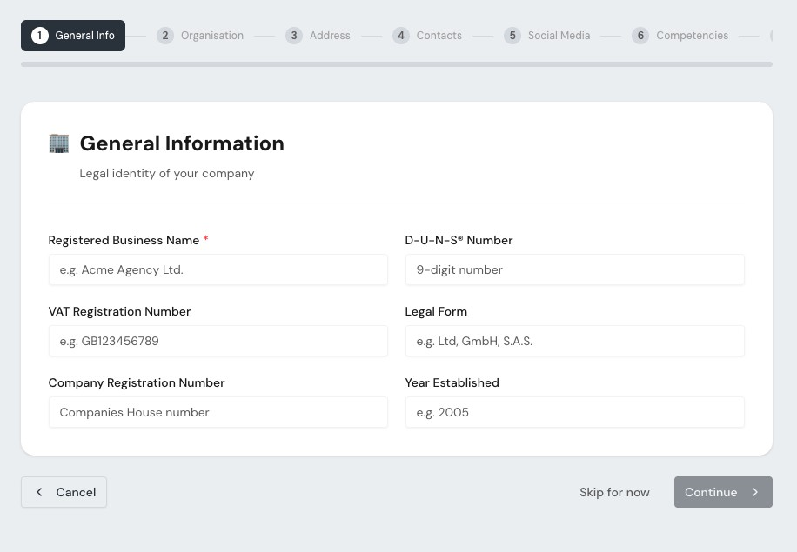
MISSED

Slide 4
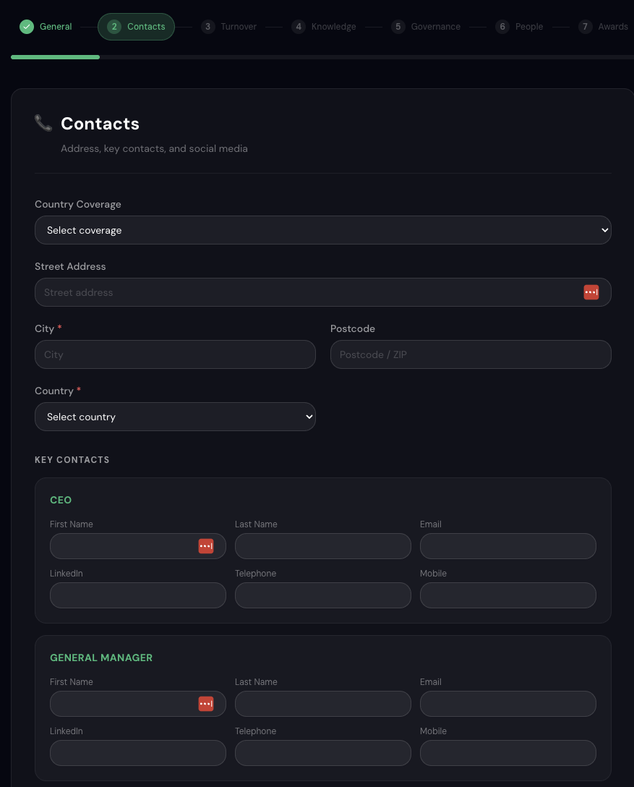
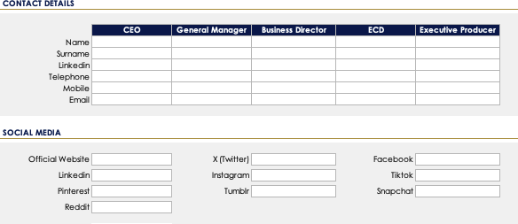
NOT REQUESTED HERE
OK

Slide 5
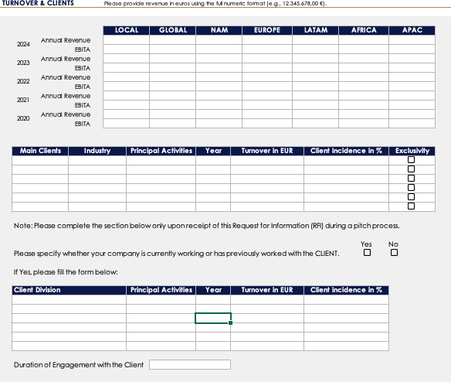
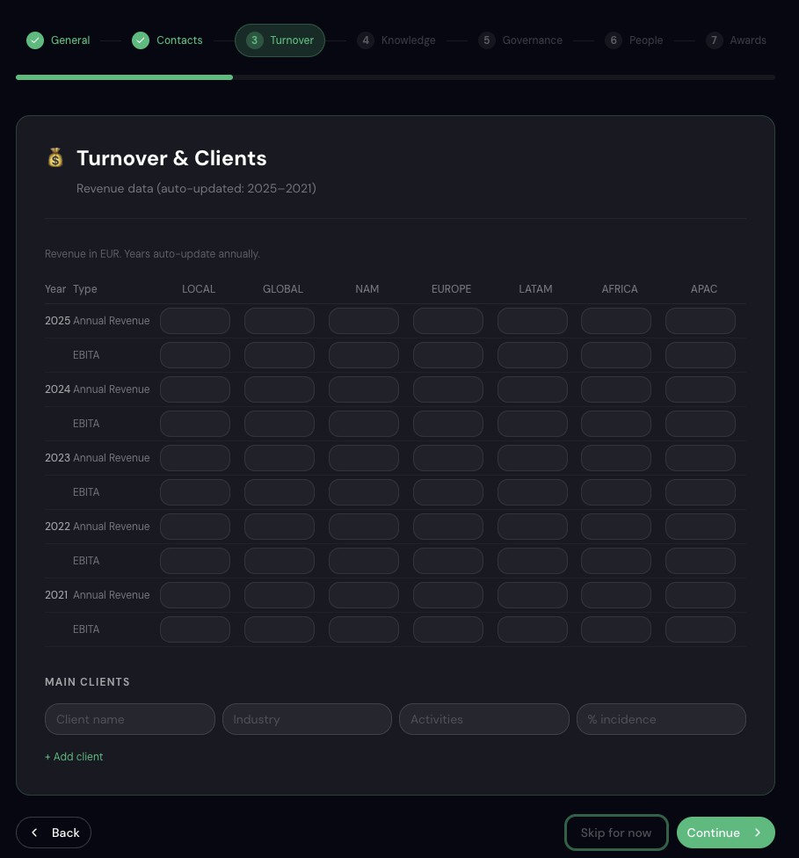
MISSED

Slide 6
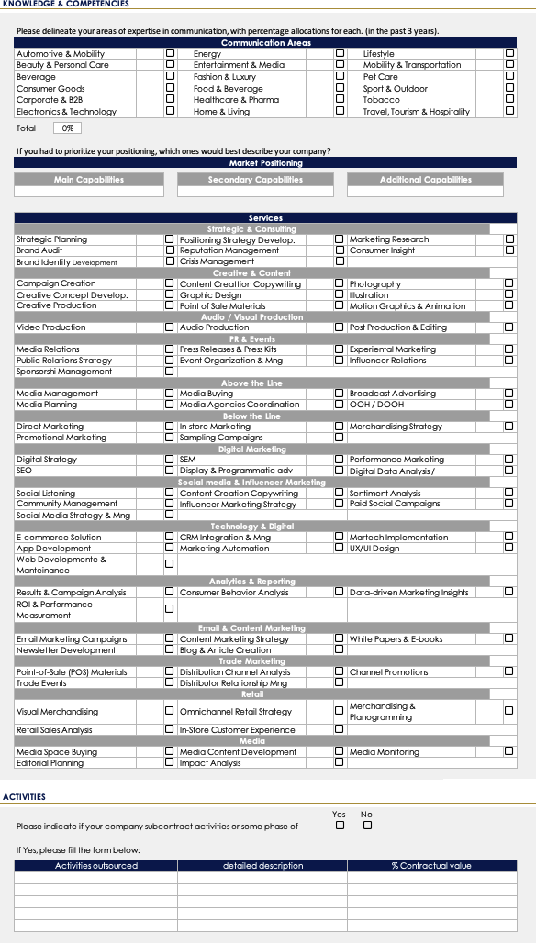
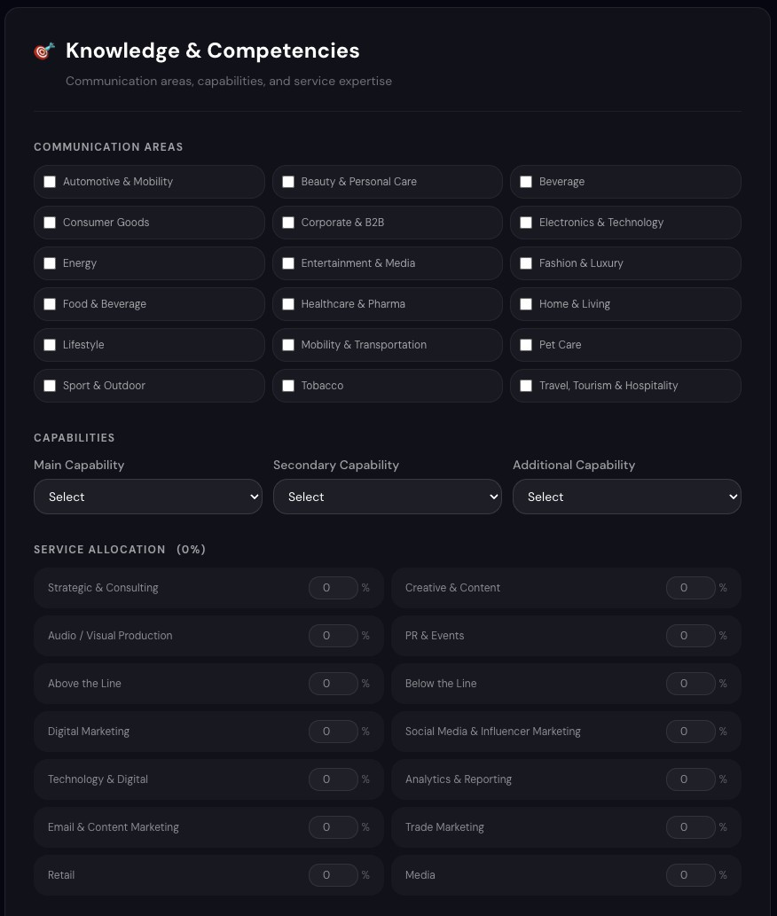
OK STRUCTURE
BUT MISS %
THESE SECTION
DOESN’T EXIST

Slide 7
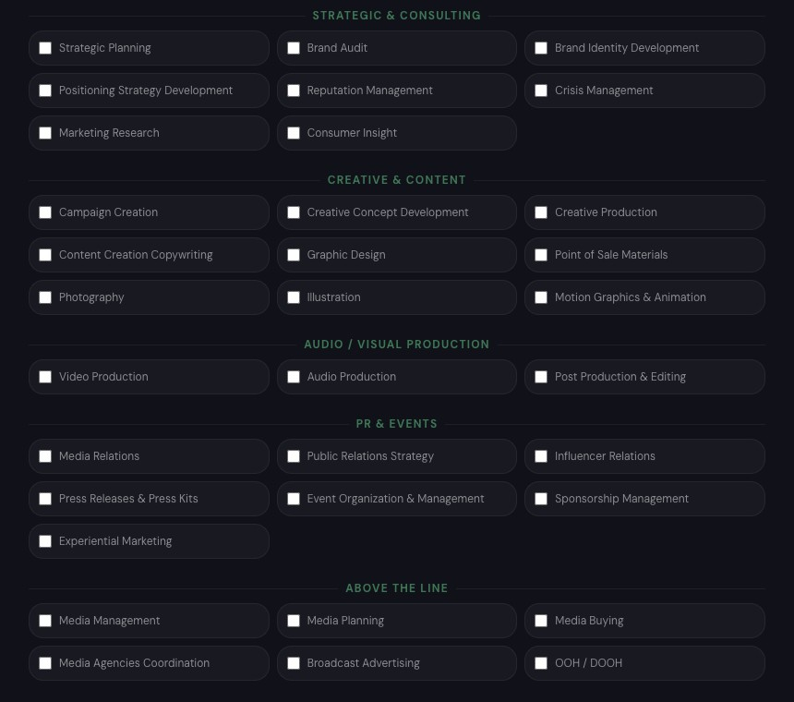
PERCENTAGE IS
MANDATORY, WE CAN REMOVE THE CHECK BOX ASSUMING THAT IF YOU CHARGE % AGENCY IS INCLUDING THIS
COMPETENCY
MISSED

Slide 8
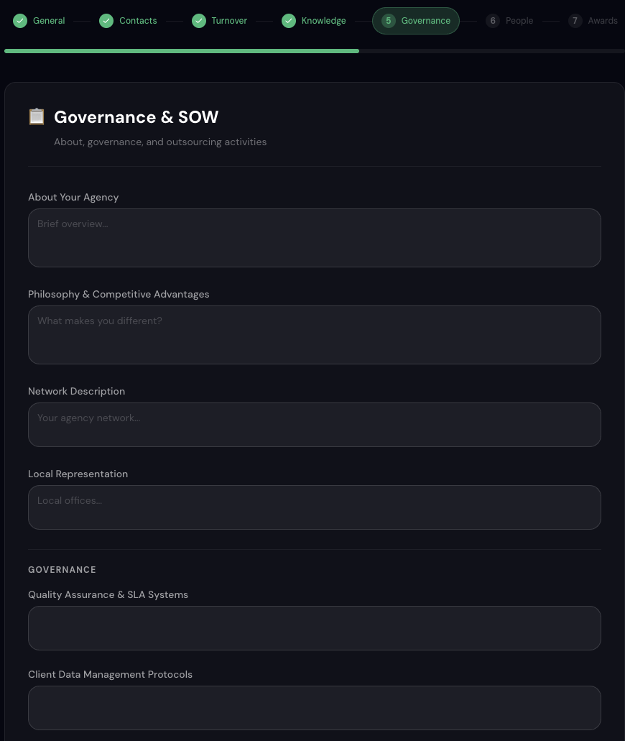
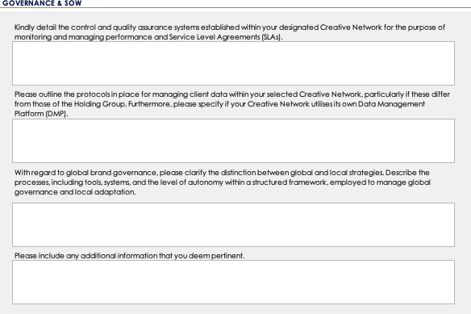
Remove as we have placed this
section in GENERAL
Use the right text

Slide 9
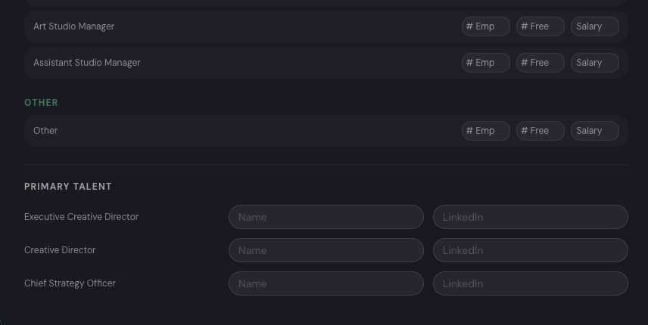
Add + as they can add more
than one
Add + as they can add more than three. Once they ad a new one they shoud be able to select the role by the list of people

Slide 10
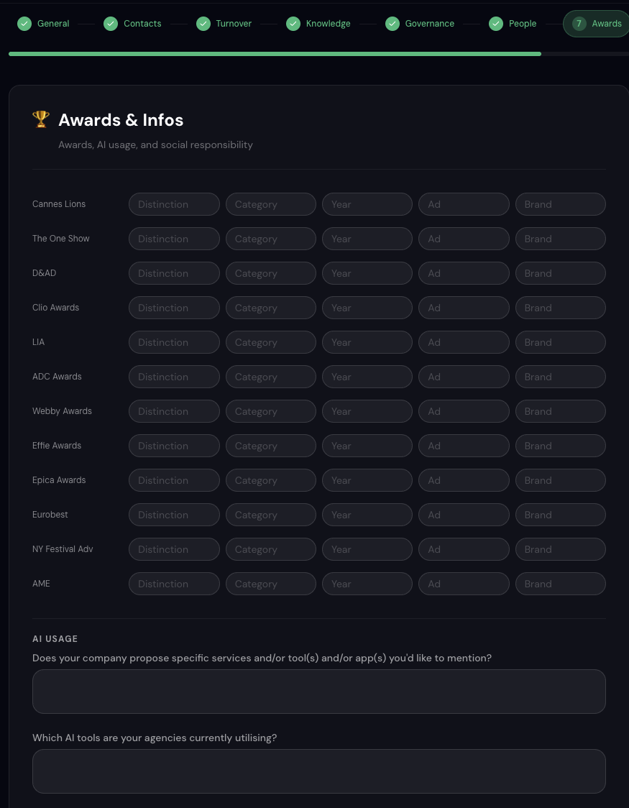
Add + as they can add more than one. They should be able to add even new award or prize
Miss Section Divider

Slide 11
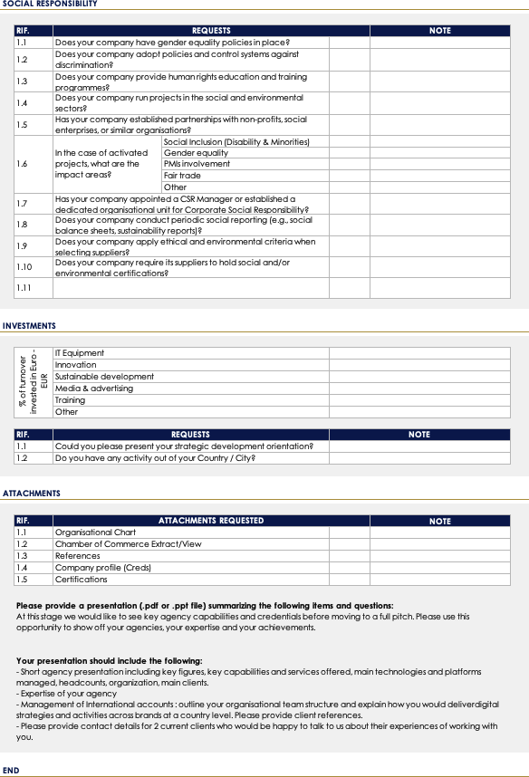
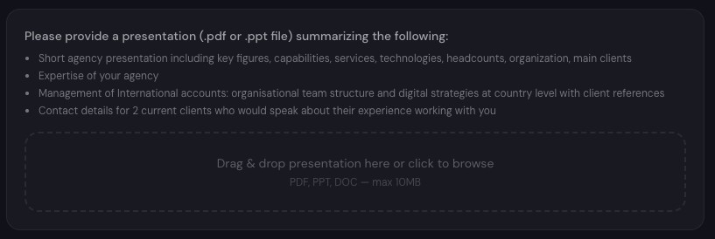
Step 8 «Add On» can include all
these requests
STILL MISSED, SOCIAL RESPONSIBILITY IS
CURRENTLY UNDER AWARDS
Pdf only

Slide 12
Beyond the visual aspect, what is fundamentally important is that the super admin must be able to modify the fields within the registration sections and/or add new stages with additional sections.
Another important note: in the Turnover s Clients section, the years must update automatically. We require a five-year historical view; therefore, in 2026 we would request 2025, 2024, 2023, 2022, 2021. In 2027, we would request 2026, 2025, 2024, 2023, 2022, and so on. This must update automatically.
Additional relevant technical aspects:
When a user completes the registration process, the profile must undergo our review before being published. Final approval and publication must be granted by us.
Users must not be allowed to register with personal email addresses. A restriction should be implemented to accept only corporate domains.

Slide 13
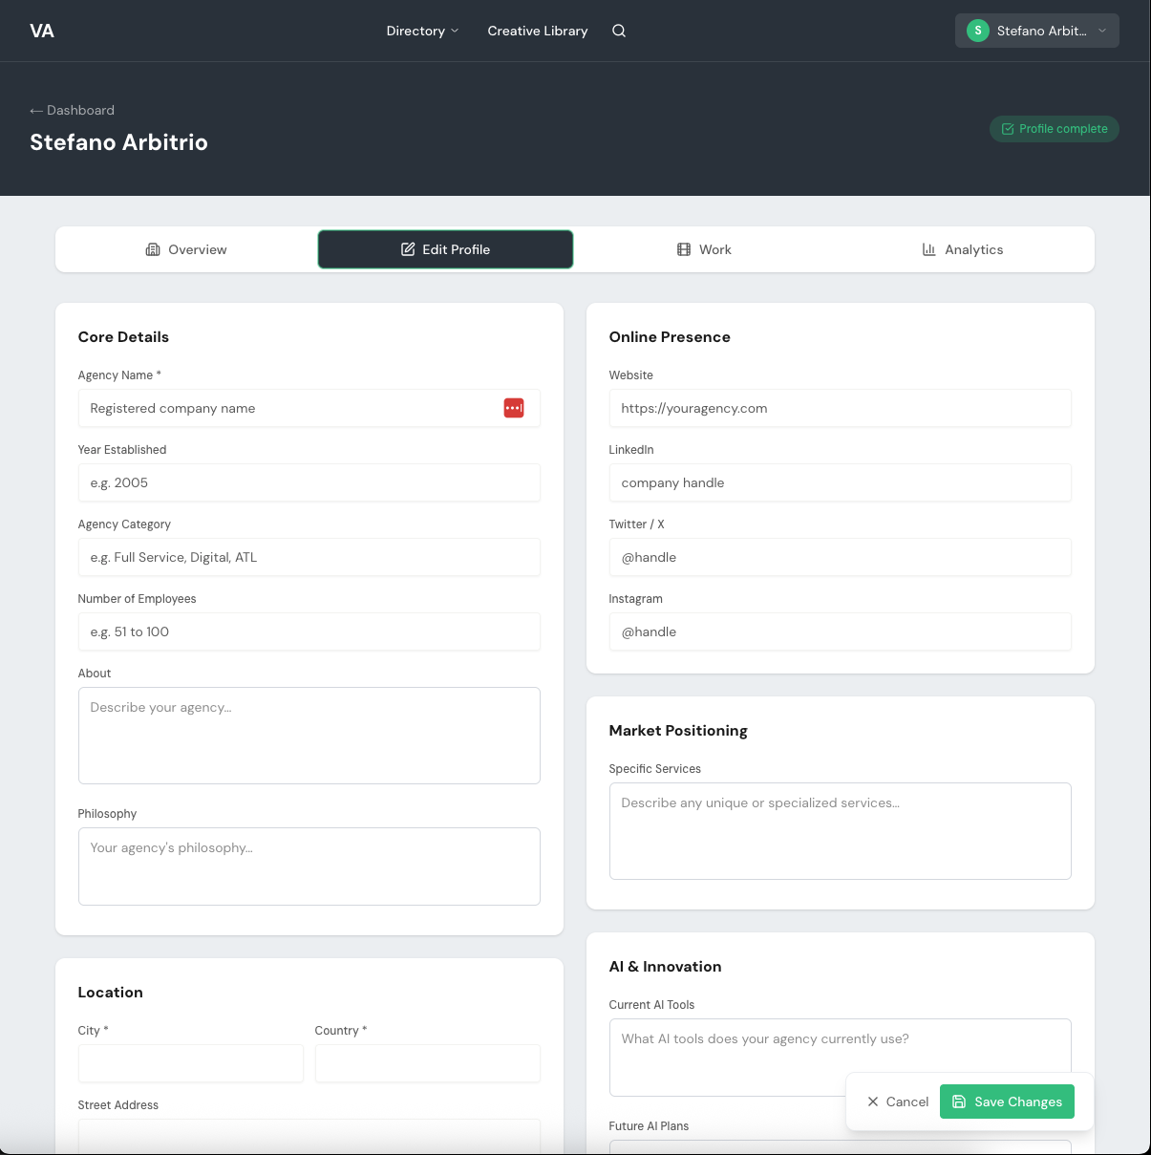

Aura
Keep the menu
Move here the user icon
Keep the same dark blue
Keep the same dark blue
An important technical note: not all fields should be editable independently by the user. By when do I need to provide you with feedback on which fields can be modified autonomously and which should require our prior approval?

Slide 14
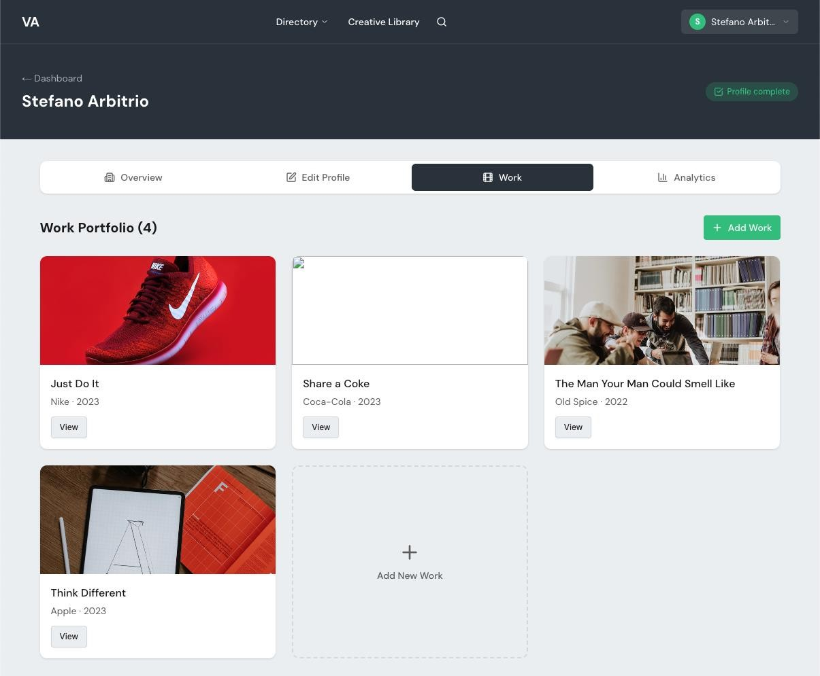
Aura
Keep the menu
Move here the user icon
Keep the same dark blue
Keep the same dark blue

Slide 15
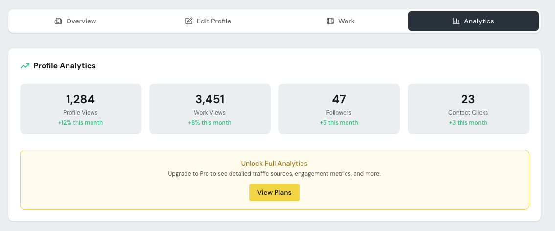
In the first phase we can hide this
section. Once the platform will be populated and it will work we can consider to share analytics

Slide 16
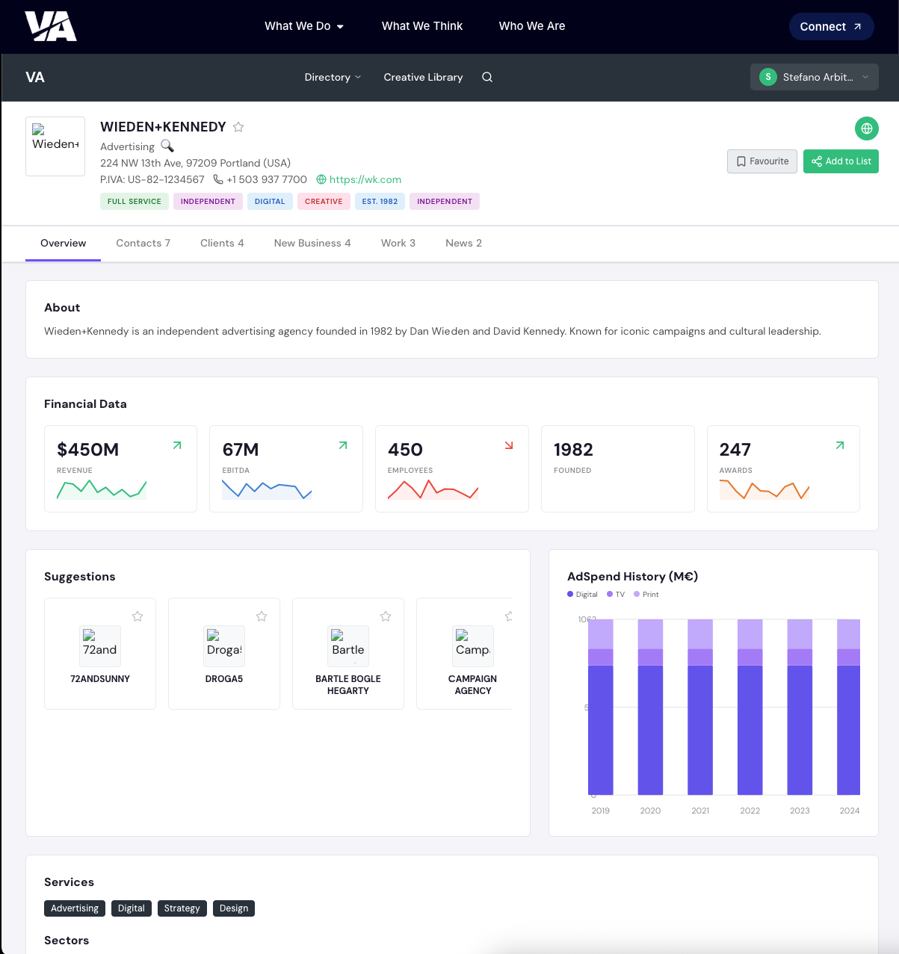
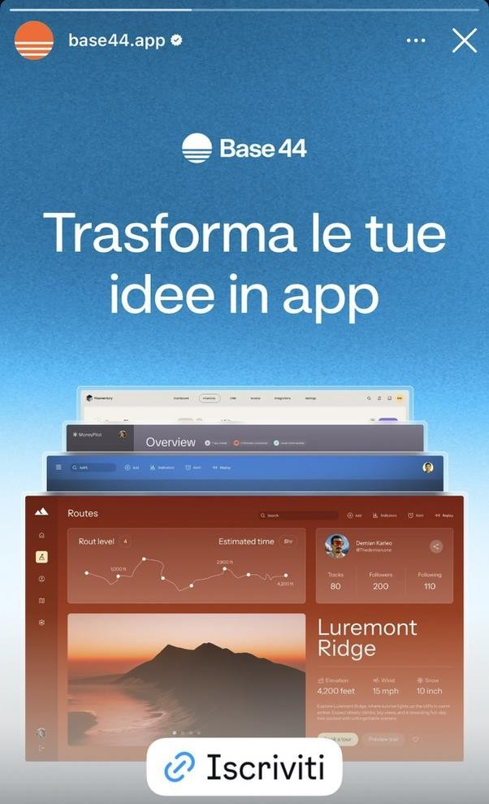
Aura
Remove and keep the same
background color
Ok but only if user has log in. Only the user (Client) can have a favourite list
Remove
As tab use the 8 steps of the registration form
Increase the size of the logo
Consider a cover image
Use website background
Fancy but not
enough.
We should also consider that we will be positioning and selling the
platform partly on
its aesthetic appeal,
particularly in
terms of how it
showcases agency
profiles.
It is therefore
essential that the
pages adopt a
refined, futuristic dark look and feel, in line with the example I am
sharing with you.
Not all these numbers need a
graphic for some of those an icon
its enough

Slide 17
Important things that we are missing on this moke up:
Anyone by using company domain can create an account
Once you have create your own account you must classify your own account: vendor or client
If you are a vendor you can add on your panel your agency, your production company or both
If you are a vendor you can see and manage just your companies, you cannot see other infos regarding registered competitors
If you are a client you cannot register companies, on a free version you can see just restricted
infos, if you pay you can have access on more layers of infos.

